Slide 1
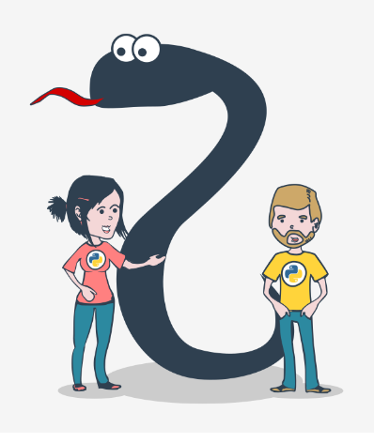
Programming Essentials in Python
Introduction to Python
Supervisor Dr. Laki Sandor
lakis@inf.elte.hu
Instructor Dhulfiqar A Alwahab
aalwahab@inf.elte.hu
What you will learn
The fundamentals of computer programming;
Setting up your programming environment;
Compilation vs. interpretation;
Introduction to Python
Data types , variables
Basic input-output operations
If statement

Slide 2
Introduction to Python
Compilation vs. interpretation
Computer programming is the act of composing the selected programming language's elements in the order that will cause the desired effect.
such a composition has to be correct in many senses:
alphabetically - a program needs to be written in a recognizable script, such as Roman, Cyrillic, etc.
lexically - each programming language has its dictionary and you need to master it; thankfully, it's much simpler and smaller than the dictionary of any natural language;
syntactically - each language has its rules and they must be obeyed;
semantically - the program has to make sense.

Slide 3
Introduction to Python
Compilation vs. interpretation(cont.)
There are two different ways of transforming a program from a high-level programming language into machine language:
COMPILATION - the source program is translated once (however, this act must be repeated each time you modify the source code).
INTERPRETATION - you (or any user of the code) can translate the source program each time it has to be run; the program performing this kind of transformation is called an interpreter.

Slide 4
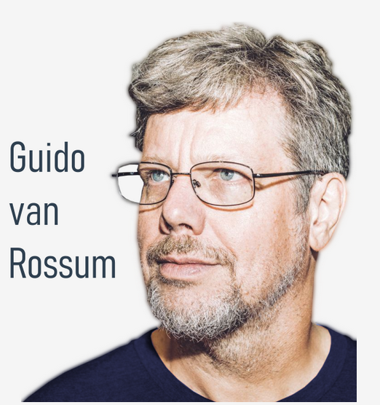
Introduction to Python
Who created Python?
Python was created by Guido van Rossum, born in 1956 in Haarlem, the Netherlands. Of course, Guido van Rossum did not develop and evolve all the Python components himself.
Python goals
In 1999, Guido van Rossum defined his goals for Python:
1. an easy and intuitive language just as powerful as
those of the major competitors;
2. open source, so anyone can contribute to its development;
3. code that is as understandable as plain English;
4. suitable for everyday tasks, allowing for short
development times.

Slide 5
Introduction to Python
Task 1
Open newfile in pyhton and type
Print (‘this is test 1 ’) ---→ what is the output ? Read it !
Print (‘this is test 1 ’ → what is the output ? Read it !
Prin ( ‘this is the test 1 ’) → what is the output ? Read it !

Slide 6
Introduction to Python
As you can see, the first program consists of the following parts:
the word print;
an opening parenthesis;
a quotation mark;
a line of text: Hello, World!;
another quotation mark;
a closing parenthesis.
Hello, World!
print("Hello, World!")
The print() function
Where do the functions come from?
They may come from Python itself; ( built-in)
they may come from one or more of Python's add-ons named modules; some of the modules come with Python, others may require separate installation.
you can write them yourself, placing as many functions as you want and need inside your program to make it simpler, clearer and more elegant.

Slide 7
Introduction to Python
In spite of the number of needed/provided arguments, Python functions strongly demand the presence of a pair of parentheses - opening and closing ones, respectively.
Arguments
Does the print() function in our example have any arguments?

Slide 8
Introduction to Python
LAB-1.1 ( 5 minutes)
use the print() function to print the line Hello, Python! to the screen. Use double quotes around the string;
having done that, use the print() function again, but this time print your first name;
remove the double quotes and run your code. Watch Python's reaction. What kind of error is thrown?
then, remove the parentheses, put back the double quotes, and run your code again. What kind of error is thrown this time?
experiment as much as you can. Change double quotes to single quotes, use multiple print() functions on the same line, and then on different lines. See what happens.

Slide 9
Introduction to Python
The print() function - instructions
print("The itsy bitsy spider climbed up the waterspout.")
print()
print("Down came the rain and washed the spider out.")
Output will be
The itsy bitsy spider climbed up the waterspout.
Down came the rain and washed the spider out.

Slide 10
Introduction to Python
The print() function - the escape and newline characters
print("The itsy bitsy spider\nclimbed up the waterspout.")
print()
print("Down came the rain\nand washed the spider out.")
How can you print only \ ? Is print(“\”) is right?
The itsy bitsy spider
climbed up the waterspout.
Down came the rain
and washed the spider out.
The backslash (\) has a very special meaning when used inside strings –
this is called the escape character.
Notes:
print("\\")

Slide 11
Introduction to Python
My-name-is-Monty-Python.
The print() function - using multiple arguments
The print() function - the keyword arguments
print("My name is", "Python.", end=“ “ )
print("Monty Python.")
print("My", "name", "is", "Monty", "Python.", sep="-“ )
The itsy bitsy spider climbed up the waterspout.
print("The itsy bitsy spider" , "climbed up" , "the waterspout.")
My name is Python. Monty Python.
My-name-is-Monty-Python.
Notes:
a keyword argument consists of three elements: a keyword identifying the argument (end here); an equal sign (=); and a value assigned to that argument;
any keyword arguments have to be put after the last positional argument (this is very important)

Slide 12
Introduction to Python
The print() function - the keyword arguments
print("My", "name", "is", sep="_", end="*")
print("Monty", "Python.", sep="*", end="*\n")
My_name_is*Monty*Python.*
Next Week Task ()
minimize the number of print() functions
Duplicate the arrow
print(" *")
print(" * *")
print(" * *")
print(" * *")
print("*** ***")
print(" * *")
print(" * *")
print(" *****")

Slide 13
Introduction to Python
Literals
A literal is data whose values are determined by the literal itself.
Example : 102 is litral but a is not.
print("2+3") → string
print(2+3)→ integer
Integers
11111111 can be written as it or 111_111_111 (+ or -)
octal
0o123 is an octal number with a (decimal) value equal to 83 → try
Hexadecimal
print(0o123)
0x123 is a hexadecimal number with a (decimal) value equal to 291 → try print (0x123)
Floats
0.4 can be written as .4 or 4.0 as 4.
3 x 10⁸ can be written 3E8 ( E comes from exponent)

Slide 14
Introduction to Python
6.62607 x 10⁻³⁴ will be 6.62607E-34
^{will be 1e-22}
Strings
Strings are used when you need to process text (like names of all kinds, addresses, novels, etc.), not numbers.
print(0.000000000000000000001)
I like "Monty Python"
print("I like \"Monty Python\"") | print(‘I like "Monty Python“’)
I'm Monty Python.
Pprint(‘I’m Monty Python’) | print("I'm Monty Python.")

Slide 15
Introduction to Python
What type of literals are the following two example
Boolean values
What will be the output ?
print(True > False)
print(True < False)
"Hello ", "007"
Write a one-line piece of code, using the print() function, as well as the newline and escape characters, to match the expected result outputted on three lines.
"I'm"
""learning""
"""Python"""
"1.5", 2.0, 528, False

Slide 16
Introduction to Python
exponentiation | print(2 ** 3)=8 print(2 ** 3.)=8.0 print(2. ** 3)=8.0 print(2. ** 3.)=8.0 | remainder (modulo) | print(14 % 4)=2 print(12 % 4.5)=3.0
multiplication | print(2 * 3)=6 print(2 * 3.)=6.0 print(2. * 3)=6.0 print(2. * 3.)=6.0 | addition | print(-4 - 4)=-8 print(4. - 8)=-4.0 print(-1.1)=- print(+2)=2
division | print(6 / 3)=2.0 print(6 / 3.)=2.0 print(6. / 3)=2.0 print(6. / 3.)=2.0
integer division | print(6 // 3)=2 print(6 // 3.)=2.0 print(6. // 3)=2.0 print(6. // 3.)=2.0
Python as a calculator
print(2+2)=4
Operators and their priorities
2 + 3 * 5
Operators and their bindings
print(9 % 6 % 2) (left binding)
print(2 ** 2 ** 3) (right binding)

Slide 17
Introduction to Python
Priority | Operator
1 | +, - | unary
2 | **
3 | *, /, %
4 | +, - | binary
print(2 * 3 % 5)=1
print((5 * ((25 % 13) + 100) / (2 * 13)) // 2)=10.0
print((2 ** 4), (2 * 4.), (2 * 4))= 16 8.0 8
print((-2 / 4), (2 / 4), (2 // 4), (-2 // 4))=-0.5 0.5 0 -1
print((2 % -4), (2 % 4), (2 ** 3 ** 2))= -2 2 512

Slide 18
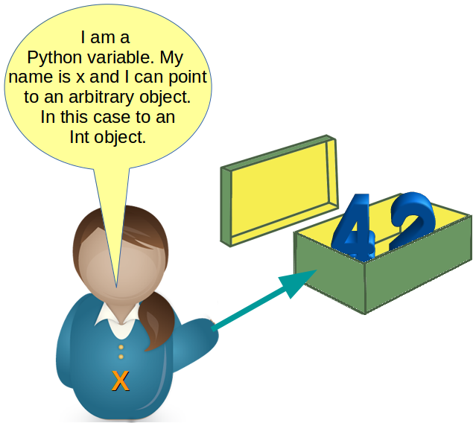
Introduction to Python
What are variables?
Correct and incorrect variable names!
(keywords are not allowed ) !
var = 1 type(var) account_balance = 1000.0 client_name = 'John Doe' print(var, account_balance, client_name) print(var) | You can use the print() statement and combine text and variables using the + operator to output strings and variables, e.g.: var = "3.7.1" print("Python version: " + var) Output Python version: 3.7.1
var = 1 print(Var) -→ error | var = 1 print(var) var = var + 1 print(var)

Slide 19
Introduction to Python(H/W)
LAB 2
Here is a short story:
Once upon a time in Appleland, John had three apples, Mary had five apples, and Adam had six apples. They were all very happy and lived for a long time. End of story.
Your task is to:
create the variables: john, mary, and adam;
assign values to the variables. The values must be equal to the numbers of fruit possessed by John, Mary, and Adam respectively;
having stored the numbers in the variables, print the variables on one line, and separate each of them with a comma;
now create a new variable named totalApples equal to addition of the three former variables.
print the value stored in totalApples to the console;
experiment with your code: create new variables, assign different values to them, and perform various arithmetic operations on them (e.g., +, -, *, /, //, etc.). Try to print a string and an integer together on one line, e.g., "Total number of apples:" and totalApples.

Slide 20
Introduction to Python
Shortcut operators
x = x * 2 | x *= 2
sheep = sheep + 1 | sheep += 1
i = i + 2 * j | i += 2 * j
var = var / 2 | var /= 2
rem = rem % 10 | rem %= 10
j = j - (i + var + rem) | j -= (i + var + rem)
x = x ** 2 | x **= 2

Slide 21
Introduction to Python
kilometers = 12.25
miles = 7.38
miles_to_kilometers = ###
kilometers_to_miles = ###
print(miles, "miles is", round(miles_to_kilometers, 2), "kilometers")
print(kilometers, "kilometers is", round(kilometers_to_miles, 2), "miles")
LAB 3
Scenario
Miles and kilometers are units of length or distance.
Bearing in mind that 1 mile is equal to approximately 1.61 kilometers, complete the program in the editor so that it converts:
miles to kilometers;
kilometers to miles.
Do not change anything in the existing code. Write your code in the places indicated by ###. Test your program with the data we've provided in the source code.
Pay particular attention to what is going on inside the print() function. Analyze how we provide multiple arguments to the function, and how we output the expected data.
Note that some of the arguments inside the print() function are strings (e.g., "miles is", whereas some other are variables (e.g., miles).
Expected output
7.38 miles is 11.88 kilometers
12.25 kilometers is 7.61 miles

Slide 22
Introduction to Python
LAB 4
Scenario
Take a look at the code in the editor: it reads a float value, puts it into a variable named x, and prints the value of a variable named y. Your task is to complete the code in order to evaluate the following expression:
3x^3 - 2x^2 + 3x - 1
The result should be assigned to y.
Remember that classical algebraic notation likes to omit the multiplication operator - you need to use it explicitly. Note how we change data type to make sure that x is of type float.
Keep your code clean and readable, and test it using the data we've provided, each time assigning it to the x variable (by hardcoding it). Don't be discouraged by any initial failures. Be persistent and inquisitive.
x = # hardcode your test data here
x = float(x)
# write your code here
print("y =", y)
Sample input
x = 0
x = 1
x = -1
Expected Output
y = -1.0
y = 3.0
y = -9.0

Slide 23
Introduction to Python
Check-point ( what is the output )
In Python, a comment is a piece of text that begins with a # (hash) sign and extends to the end of the line.
Example
# This program evaluates the hypotenuse c.
NOTE: If you'd like to quickly comment or uncomment multiple lines of code, select the line(s) you wish to modify and use the following keyboard shortcut: CTRL + / (Windows) or CMD + / (Mac OS).
var = 2 var = 3 print(var) | # print("String #1") print("String #2")
my_var m 101 averylongvariablename m101 m 101 Del del, end , sep | # This is a multiline comment. # print("Hello!")
a = '1' b = "1" print(a + b)
a = 6 b = 3 a /= 2 * b print(a)

Slide 24
Introduction to Python
The input() function
NOTE:
The result of the input() function is a string.
Run this code in your PC.
anything = input("Enter a number: ")
something = anything ** 2.0
print(anything, "to the power of 2 is", something)
Example -1
print("Tell me anything...")
anything = input(“plz enter nu”)
print("Hmm...", anything, "... Really?")
Example -2
anything = input("Tell me anything...")
print("Hmm...", anything, "...Really?")
Type casting is used to solve this problem
int() and float()
Example
anything = float(input("Enter a number: "))
something = anything ** 2.0
print(anything, "to the power of 2 is", something)

Slide 25
Introduction to Python
Example:
fnam = input("May I have your first name, please? ")
lnam = input("May I have your last name, please? ")
print("Thank you.")
print("\nYour name is " + fnam + " " + lnam + ".")
String operators – introduction
Concatenation
The + (plus) sign, when applied to two strings, becomes a concatenation operator:
string + string
Replication
The * (asterisk) sign, when applied to a string and number (or a number and string, as it remains commutative in this position) becomes a replication operator:
string * number
number * string
Example 1,
"James" * 3 gives "JamesJamesJames"
3 * "an" gives "ananan"
5 * "2" (or "2" * 5) gives "22222" (not 10!)
Example 2, run this code
print("+" + 10 * "-" + "+") o/p +----------+
print(("|" + " " * 10 + "|\n") * 5, end="")
print("+" + 10 * "-" + "+")

Slide 26
Introduction to Python
What is the output of the following snippet?
x = int(input("Enter a number: "))
# the user enters 2
print( 2 * "5")
______
What is the expected output of the following snippet?
x = input("Enter a number: ")
# the user enters 2
print(type(x))
Type conversion: str()
convert a number into a string : str(number)
Example
leg_a = float(input("Input first leg length: "))
leg_b = float(input("Input second leg length: "))
print("Hypotenuse length is " + str((leg_a**2 + leg_b**2) ** .5))
Notes:
55
<class ‘str’>

Slide 27
Introduction to Python(H/W)
LAB
Scenario
Your task is to complete the code in order to evaluate the results of four basic arithmetic operations.
The results have to be printed to the console.
You may not be able to protect the code from a user who wants to divide by zero. That's okay, don't worry about it for now.
Test your code - does it produce the results you expect?
We won't show you any test data - that would be too simple.
# input a float value for variable a here
# input a float value for variable b here
# output the result of addition here
# output the result of subtraction here
# output the result of multiplication here
# output the result of division here
print("\nThat's all, folks!")

Slide 28
Introduction to Python(H/W)
LAB
Scenario
Your task is to prepare a simple code able to evaluate the end time of a period of time, given as a number of minutes (it could be arbitrarily large). The start time is given as a pair of hours (0..23) and minutes (0..59). The result has to be printed to the console.
For example, if an event starts at 12:17 and lasts 59 minutes, it will end at 13:16.
Don't worry about any imperfections in your code - it's okay if it accepts an invalid time - the most important thing is that the code produce valid results for valid input data.
Test your code carefully. Hint: using the % operator may be the key to success.
hour = int(input("Starting time (hours): "))
mins = int(input("Starting time (minutes): "))
dura = int(input("Event duration (minutes): "))
# put your code here

Slide 29
Introduction to Python
Comparison:
equality operator (==) print(2==2) output will be true
Inequality: the not equal to operator (!=) print(2!=2) output will be false
greater than (>) print (2>2) output will be false
greater than or equal to (≥) output only true or false
less than or equal to (≤) output only true or false
Priority | Operator
1 | +, - | unary
2 | **
3 | *, /, //, %
4 | +, - | binary
5 | <, <=, >, >=
6 | ==, !=

Slide 30
Introduction to Python
Conditions and conditional execution
if true_or_not:
4spaces OR tab (not both) do_this_if_true
Nested if-else statements
if the_weather_is_good:
if nice_restaurant_is_found:
have_lunch()
else:
eat_a_sandwich()
else:
if tickets_are_available:
go_to_the_theater()
else:
go_shopping()
The elif statement
if the_weather_is_good
go_for_a_walk()
elif tickets_are_available:
go_to_the_theater()
elif table_is_available:
go_for_lunch()
else:
play_chess_at_home()
if sheep_counter >= 120:
make_a_bed()
take_a_shower()
sleep_and_dream()
feed_the_sheepdogs()
Error in indentation
If –else
if :true_or_false_condition
perform_if_condition_true
else:
perform_if_condition_false
-------------------------------------------
if the_weather_is_good:
go_for_a_walk()
have_fun()
else:
go_to_a_theater()
enjoy_the_movie()
have_lunch()

Slide 31
Introduction to Python
Find the largest of three numbers
# read three numbers
number1 = int(input("Enter the first number: "))
number2 = int(input("Enter the second number: "))
number3 = int(input("Enter the third number: "))
# We temporarily assume that the first number
# is the largest one.
# We will verify this soon.
largest_number = number1
# we check if the second number is larger than current largest_number
# and update largest_number if needed
if number2 > largest_number:
largest_number = number2
# we check if the third number is larger than current largest_number
# and update largest_number if needed
if number3 > largest_number:
largest_number = number3
# print the result
print("The largest number is:", largest_number)
Example: larger between two number
# read two numbers
number1 = int(input("Enter the first number: "))
number2 = int(input("Enter the second number: "))
# choose the larger number
if number1 > number2:
larger_number = number1
else:
larger_number = number2
# print the result
print("The larger number is:", larger_number)

Slide 32
LAB ( IMPORTANT!) (who will do it ?)
Scenario
Once upon a time there was a land - a land of milk and honey, inhabited by happy and prosperous people. The people paid taxes, of course - their happiness had limits. The most important tax, called the Personal Income Tax (PIT for short) had to be paid once a year, and was evaluated using the following rule:
if the citizen's income was not higher than 85,528 thalers, the tax was equal to 18% of the income minus 556 thalers and 2 cents (this was the so-called tax relief)
if the income was higher than this amount, the tax was equal to 14,839 thalers and 2 cents, plus 32% of the surplus over 85,528 thalers.
Your task is to write a tax calculator.
It should accept one floating-point value: the income.
Next, it should print the calculated tax, rounded to full thalers. There's a function named round() which will do the rounding for you - you'll find it in the skeleton code in the editor.
Note: this happy country never returns money to its citizens. If the calculated tax is less than zero, it only means no tax at all (the tax is equal to zero). Take this into consideration during your calculations.
Look at the code in the editor - it only reads one input value and outputs a result, so you need to complete it with some smart calculations.
Test your code using the data we've provided.
income = float(input("Enter the annual income: "))
#
# Put your code here.
#
tax = round(tax, 0)
print("The tax is:", tax, "thalers")
Test Data
Sample input: 10000
Expected output: The tax is: 1244.0 thalers
Sample input: 100000
Expected output: The tax is: 19470.0 thalers
Sample input: 1000
Expected output: The tax is: 0.0 thalers
Sample input: -100
Expected output: The tax is: 0.0 thalers

Slide 33
Introduction to Python
Congratulations!
You covered :
the basic methods of formatting and outputting data offered by Python, together with the primary kinds of data and numerical operators, their mutual relations and bindings;
the concept of variables and variable naming conventions;
the assignment operator, the rules governing the building of expressions;
the inputting and converting of data;
Use if statements

